Slide 1
Signal localization and BG suppression in THz s-SNOM
Rainer Hillenbrand
Brno, Oct. 2018

Slide 2
Standard s-SNOM
Standard s-SNOM with nonmagnetic samples:
External illumination polarizes the tip, yielding the background dipole P₀ and creating the hot-spot at the tip apex.
Polarized tip interacts with the sample via near fields in this hot spot yielding, an additional induced dipole P_{ind}
The detected signal is due to radiation of both background and induced dipoles:
E_{s} ∝ P = P₀ + P_{ind}
P₀ is dominant and is typically suppressed by jittering the tip and demodulating the detector signalat higher harmonic of this jittering frequency.
E_{s}
E_{i}
P
E

Slide 3
s-SNOM with magnetic hot spot
E_{s}
s-SNOM with paramagnetics:
We assume that the signal formation mechanism for magnetic antenna tip is similar to that in standard s-SNOM, i.e. the signal is still due to background and induced dipoles (potentially with different polarization):
E_{s} ∝ P = P₀ + P_{ind}
E_{i}
P
B
Since the tip is assumed to be nonmagnetic, one can suppress the background scattering associated with P₀ by modulating the static magnetic field B₀ and demodulating the detector signal at the magnetic field modulation frequency, instead of using the tip jittering technique.
In the following, we analyze the spatial localization (i.e. resolution) of the induced dipole when the tip is not jittered.
Importantly, the analysis presented here is for standard (i.e. electric antenna) tips of nonmagnetic materials. We assume that the signal localization for magnetic antenna tips is similar to that of standard tips with the same tip size and the conclusions of this study will be valid for magnetic antenna tips.

Slide 4
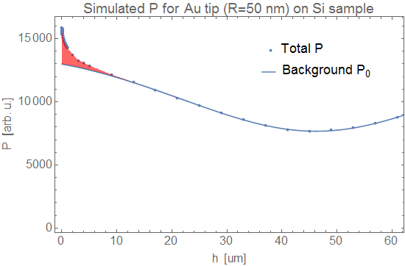
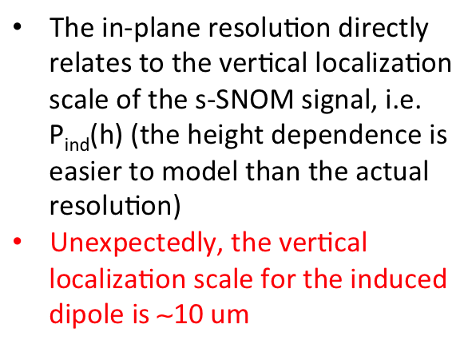
Induced vs. Background dipole
Au
20 um
R
h
Si
The in-plane resolution directly relates to the vertical localization scale of the s-SNOM signal, i.e.P_{ind}(h) (the height dependence is easier to model than the actual resolution)
Unexpectedly, the vertical localization scale for the induced dipole is ∼10 um
P_{ind}
∼10 um

Slide 5
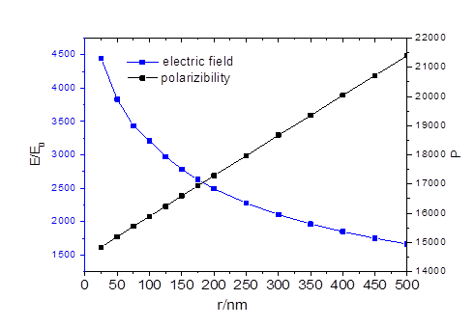
Large tips increase near-field signal
R
Field enhancement, E/E₀
Tip dipole, P [arb. u.]
tip radius, R [nm]
Large tips provide larger tip-sample coupling, thus stronger near-field signal, although the field enhancement reduces

Slide 6
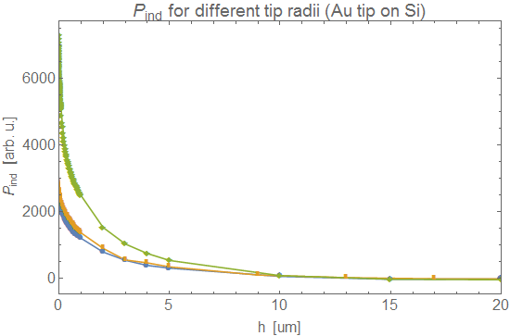

Field localization barely depends on tip radius
Surprisingly, the localization scale for the induced dipole is on the same scale ∼10 um disregarding the tip radius

Slide 7
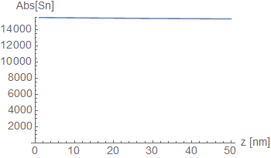
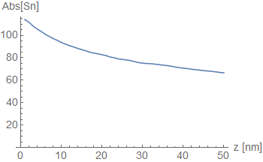

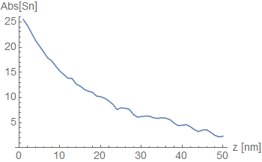
High-harmonic Demodulation
Simulation with A=50 nm
s₀
normally in s-SNOM the tip is jittered at frequency Ω nd small amplitude A<<λ and the signal is demodulated at harmonics nΩ
The demodulated signal can be calculated as
low harmonics contain BG
high harmonics “filter our” the BG and localize signal to the nm scale, but at the expense of signal strength (∼2 orders of magnitude)
s₁
∼ 50 nm
s-SNOM owes nanoscale spatial resolution primarily to the demodulation technique, and not simply small tip radius.
s₂

Slide 8
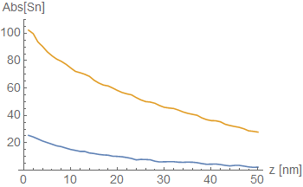
Signal localization after high-harmonic demodulation for large tips
s₂
R=500 nm
R=50 nm
Larger tips provide stronger signal,
yet still offer spatial resolution on the 100 nm scale (for small tapping amplitudes (A<<R)

Slide 9
Experiment with standard s-SNOM tips
R
experiment: signal enhancement
experimental resolution
dielectric
metal
metal
dielectric
Experimental results confirming the signal enhancement by large tips

Slide 10
Large tips for boosting magnetic near-field signals the signal
Large tips are suitable for patterning of near-planar magnetic structure that are (potentially) beneficial for EPR detection.
z
x
x
y
z
B
x
magnetic antenna tip

Slide 11
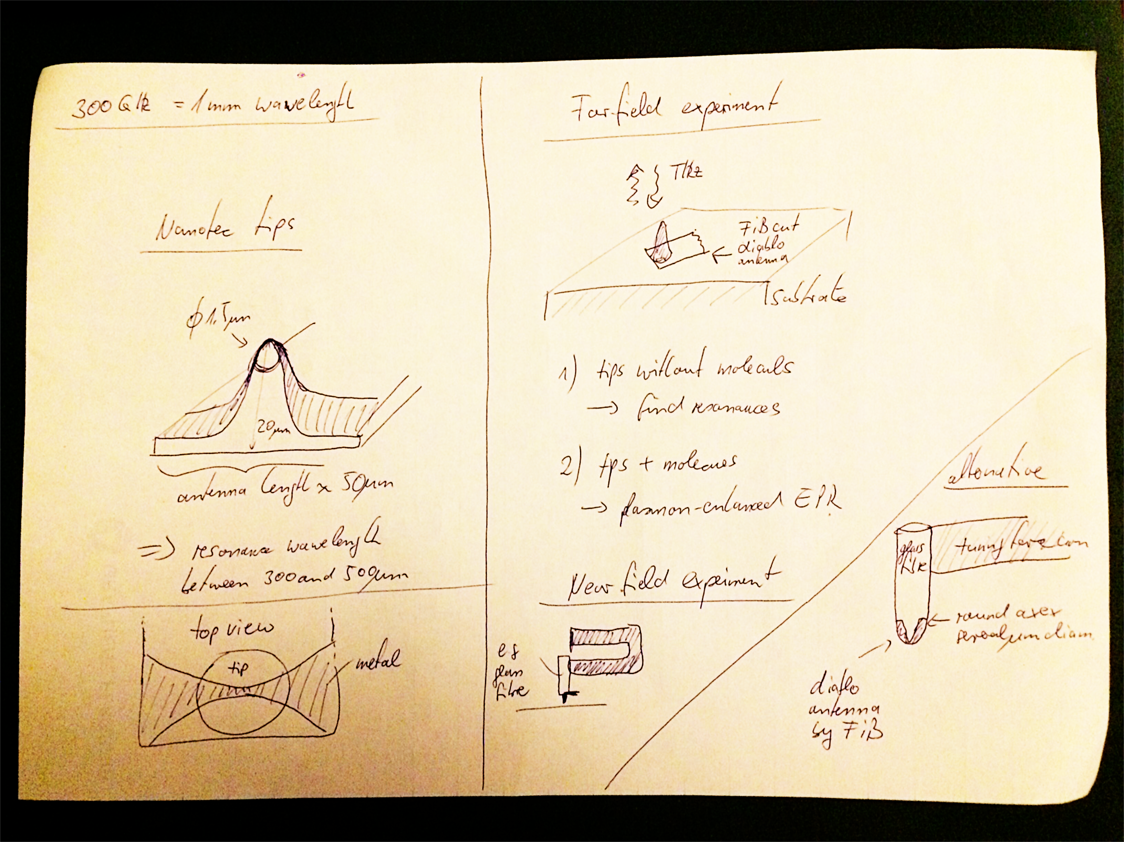

Slide 12
Conclusions
Without demodulation expect spatial resolution ∼10 um
Demodulation technique can bring nanoscale spatial resolution down to 100 nm scale, but at the expense of lower signal.
Large tips can boost the signal and provide large area for patterning of magnetic structures.

