Slide 1

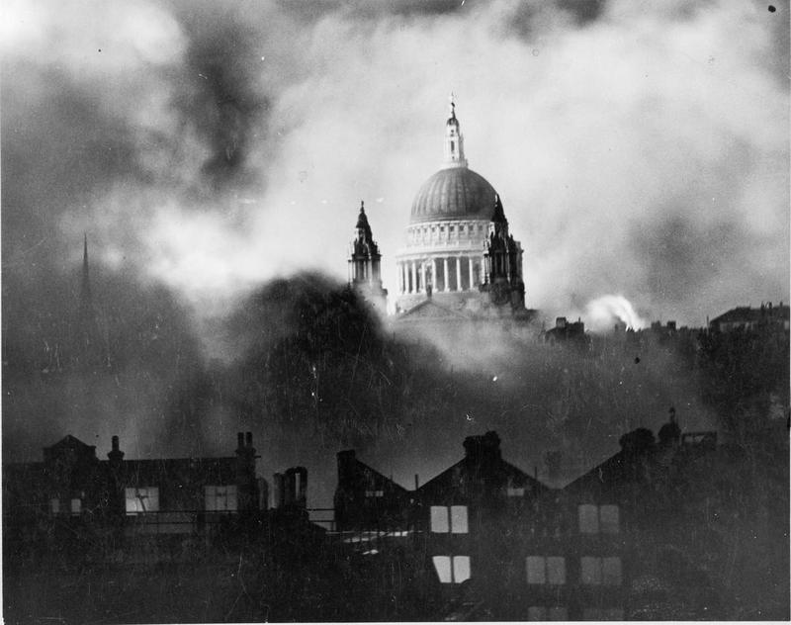
About Thomas Keating
Thomas Keating started - so we believe - in the 1780's off St Paul's Churchyard in the City of London. It was a chemists shop and through the 19 Century developed two products: A cough lozenge sold during the winter and an Insecticide sold during the summer.

Slide 2
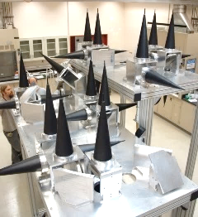
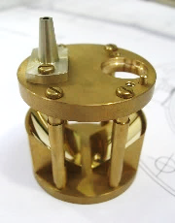
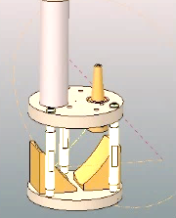
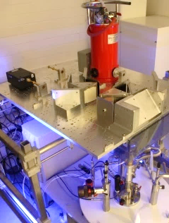
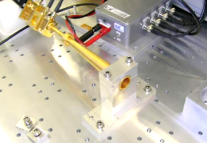
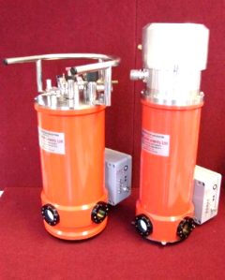

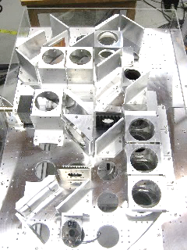
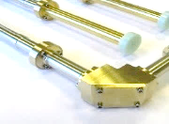
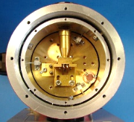
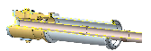


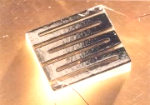
About Thomas Keating
Quasi-optical ESR bridges and probes
For over 20 years TK has been working with leading experimental scientists to design and build high field EPR and DNP bridges.
Predominately working at W-band and above, and drawing upon expertise at the University of St Andrews, we have installations in universities and national labs around the world.
Examples of our systems and products are shown here, including low loss quasi-optics and HE11 probes, and cooled broad-band detector technologies.
Our customers include groups at CNRS Grenoble, St Andrews, Stuttgart, EPFL Lausanne, Heidelberg, Pisa, Saclay, Nottingham, Warwick, Mulheim, Berlin Frankfurt, MIT, NHMFL, Cornell, Yale, UF Gainesville, Northeastern, Northwestern, John Hopkins, PNNL, UCSB and Weizmann Institute of Science.
ESR bridges
TK and QMC manufacture quasi-optical QO benches, free-space isolators, refocussing mirrors, feed horns, corrugated waveguides and tapers, wire grid polarisers, RF absorber loads, lenses, free-space filters and detector systems. We regularly collaborate with Virginia Diodes Inc. who supply other detectors and sources.
ESR probes
Based on HE11 corrugated circular German/nickel silver waveguides with cryostat heads and corrugated tapers, these are used to provide efficient transmission along magnet bores and through cryostats.
Detector systems
Our sister company QMC Instruments offers a range of high-sensitivity (1 pW/Hz^{½}) detectors that operate at 4 K and below, including systems packaged with our own cryostats, optics, filters and amplifiers.
Superconducting bolometer
InSb HEB (hot electron bolometer)
Magnetically enhanced InSb HEB
Doped germanium photoconductor
Weizmann ESR probe head
HiPER spectrometer
Weizmann ESR probe head mirrors
Stuttgart ESR spectrometer
Ultra-Gaussian feed horn & VDI multipliers
LHe and dry detector systems
Corrugated waveguide with mitre bend
FSU NHMFL DNP QO bench
Stuttgart ESR probe
Cryostat and bolometer
InSb hot electron bolometer

Slide 3
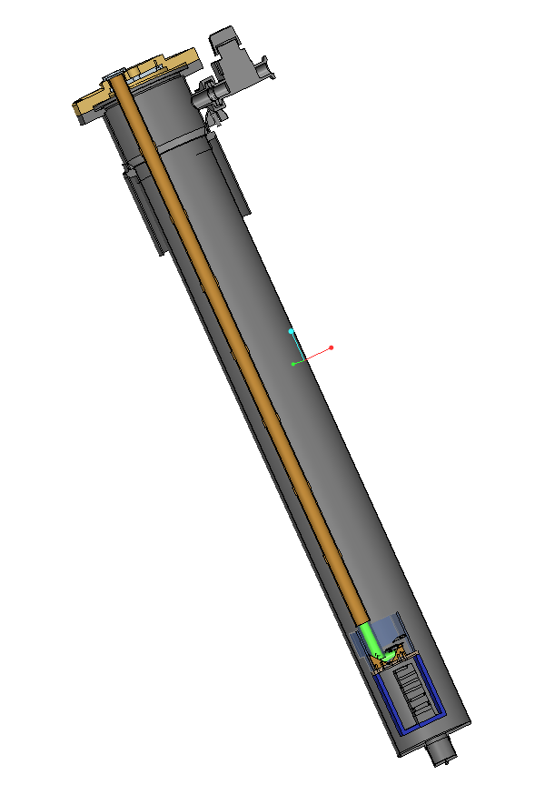
Colleagues from TK
Dr Kevin Pike – Project Scientist
George Sebek – Designer
David Roberts – Commercial Manager
Alisa Leavesley – UCSB Chemistry

Slide 4
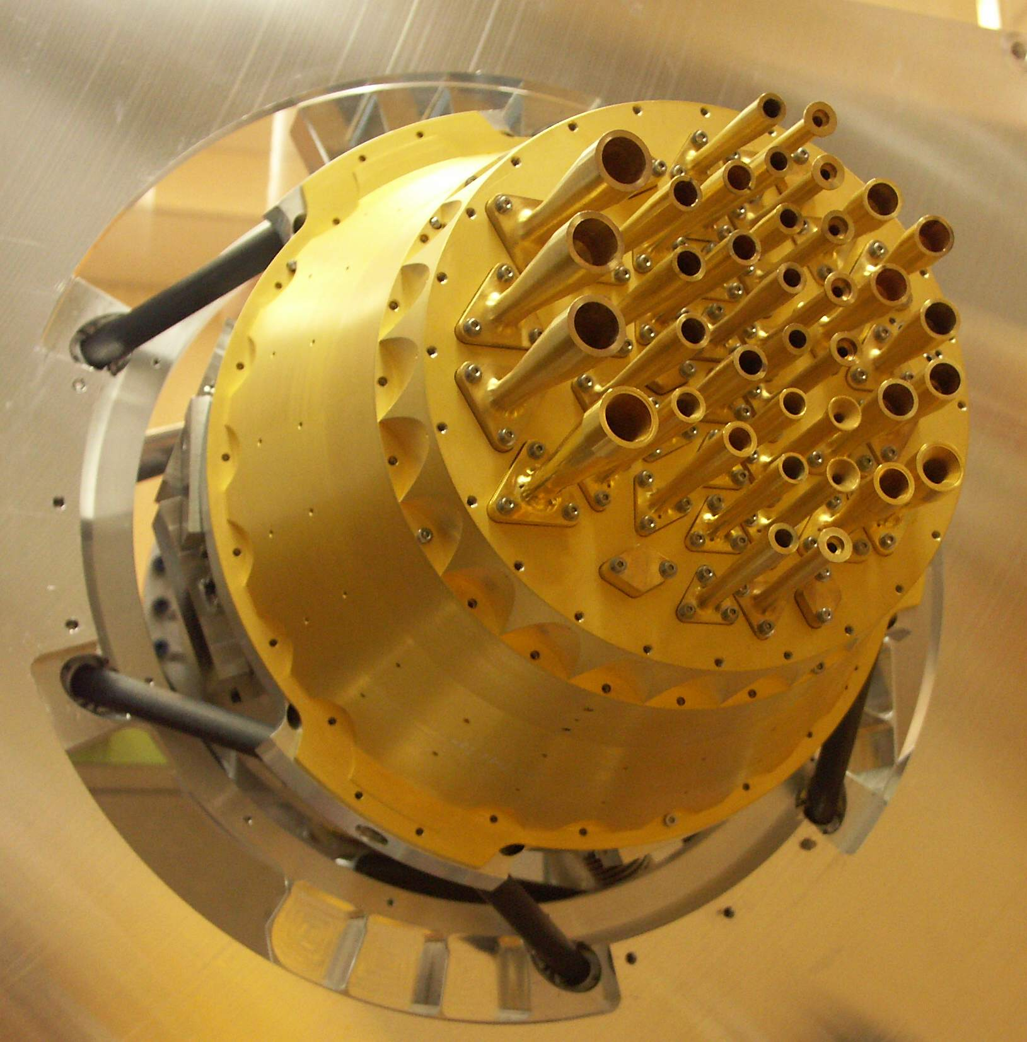
HF EPR enabled by Quasi-Optical Components
Subtitle:
Cross Fertilization of Instrument Design
Richard Wylde FREng

Slide 5
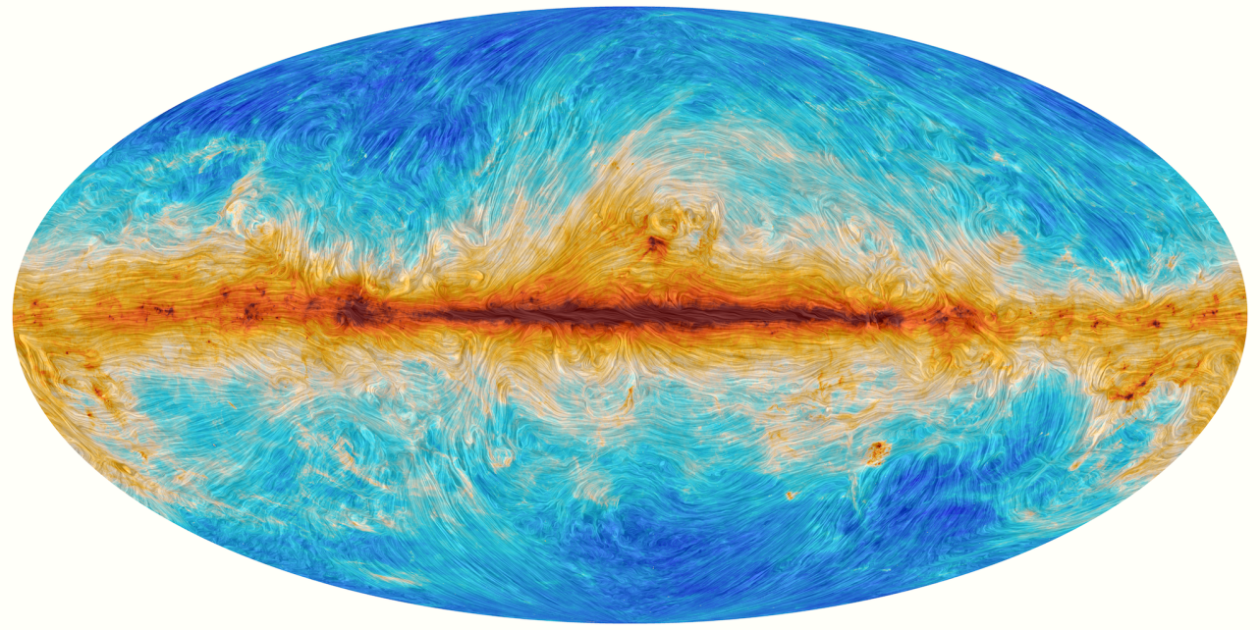
HF EPR enabled by
Quasi-Optical Components
ESA’s Planck
CMB Missions
Magnetic field lines traced by dust emission at 353 GHz

Slide 6
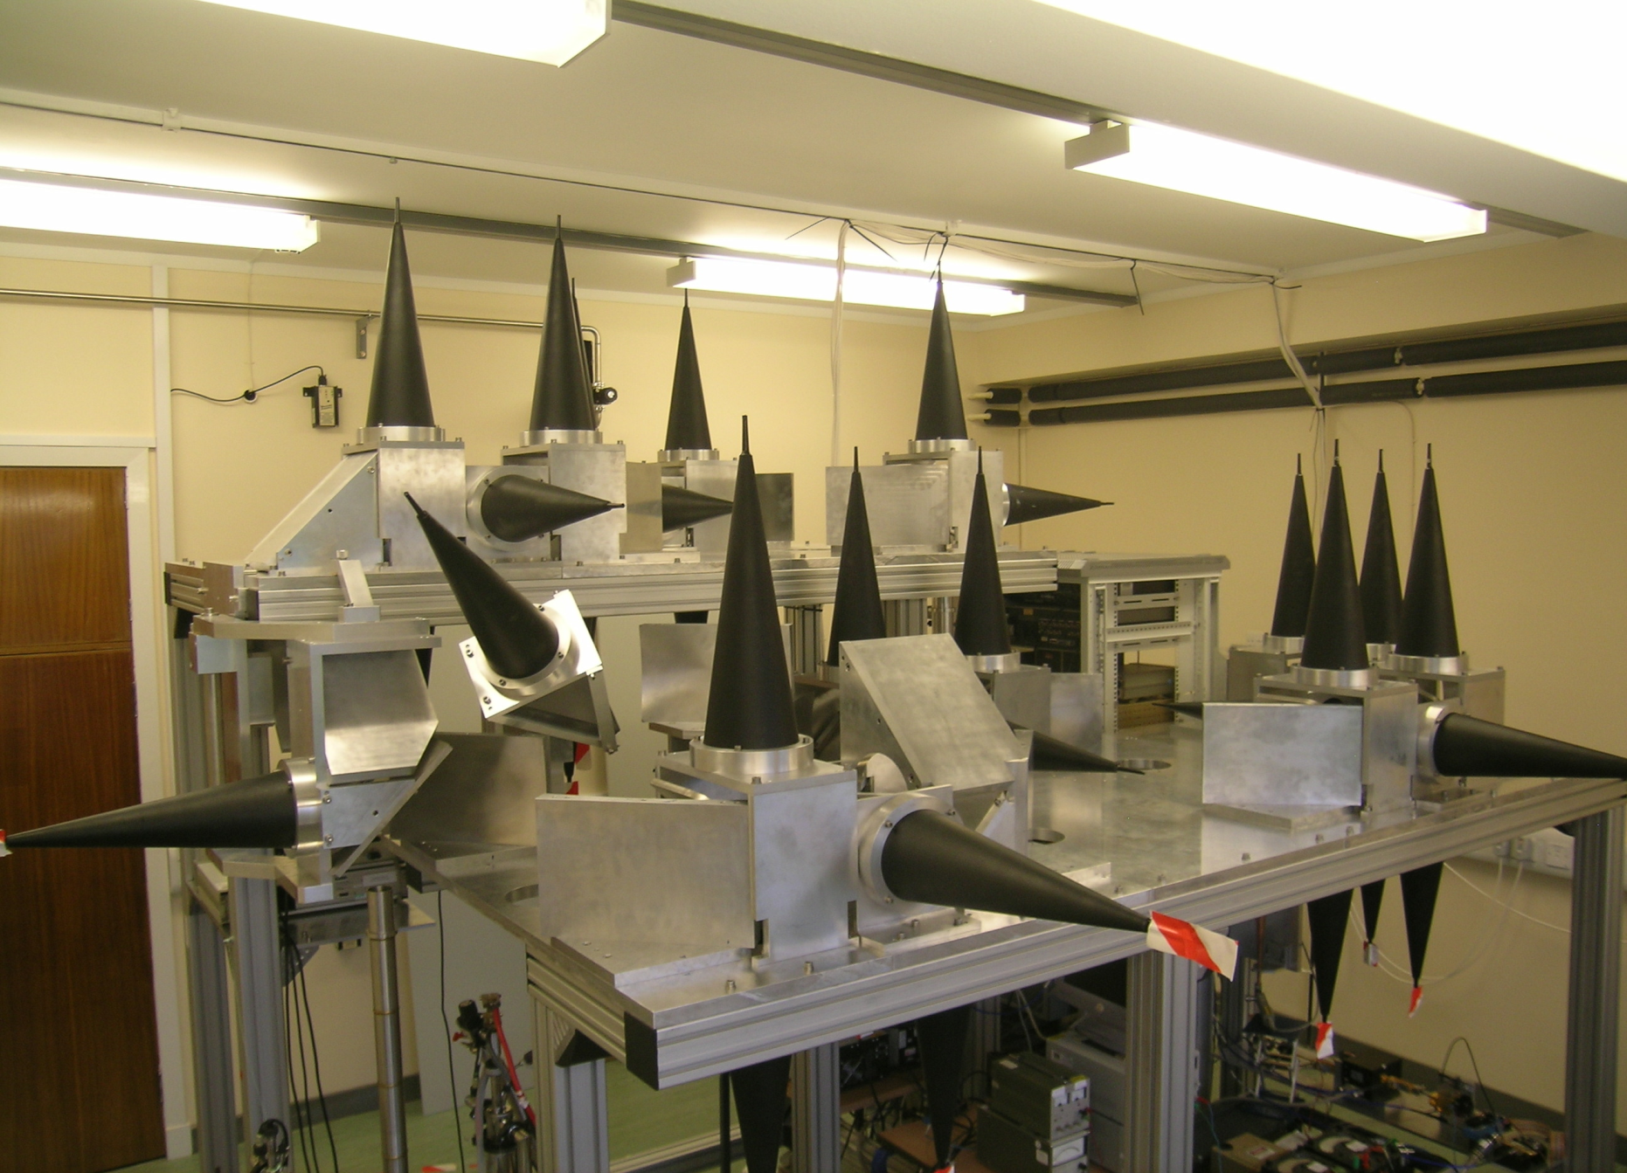
The Optics of HiPER

Slide 7
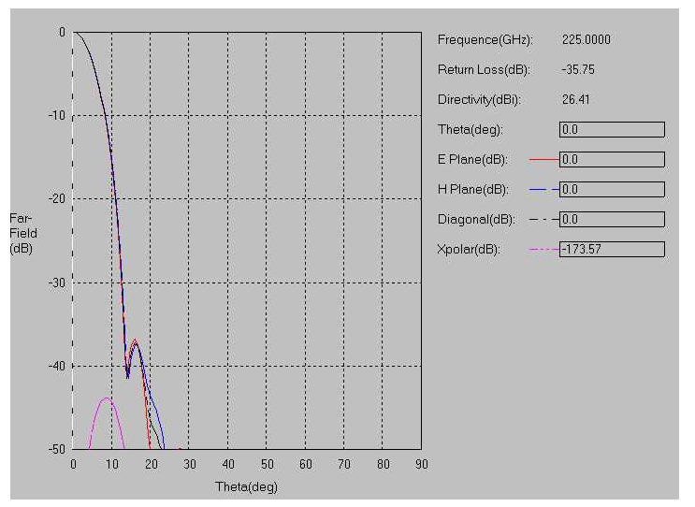
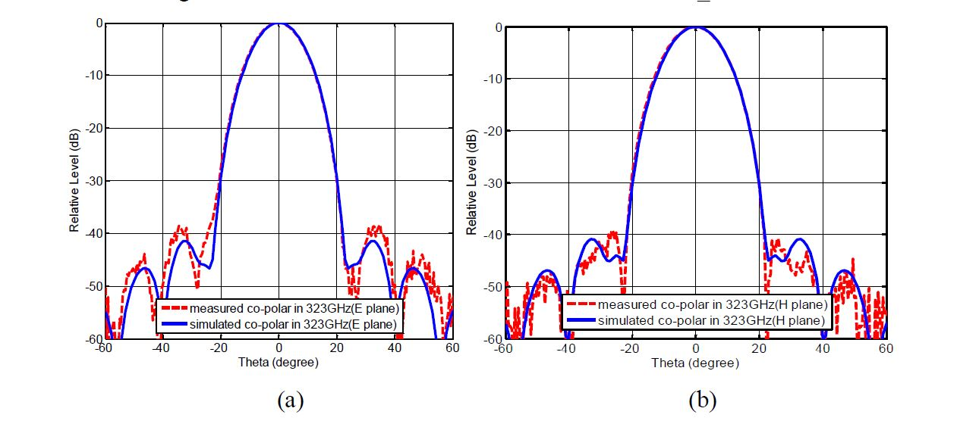
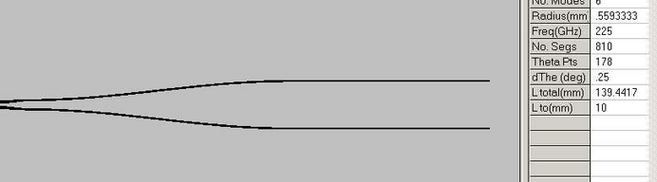
Ultra-Gaussian Horns allow the simple Gaussian Beam
mode approach to be used to design low loss systems

Slide 8
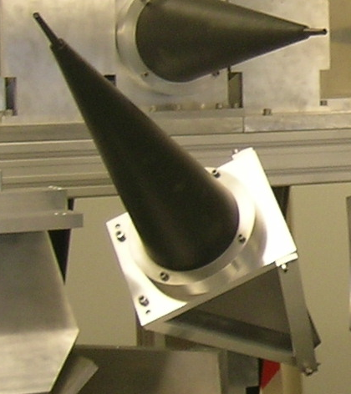
Termination
Terminations are very important in low loss systems: Witch’s Hat load
Injection formed by absorbing plastic and specially built injection mould to give S11 performance at -80dB level.

Slide 9
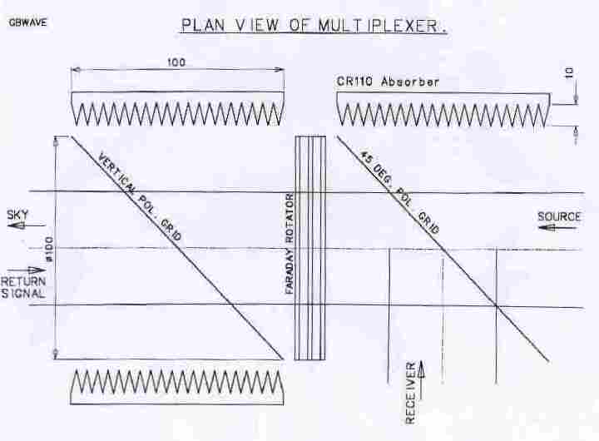
Isolation
Standing waves within instruments must be low enough not to compete with the very small signals: QO isolators can be used to suppress these.
Quasi-optical isolators use impedance matched hard ferrite to provide non-reciprocal Faraday rotation of the polarization of the beam and polarizing wire grids to extract the signal.

Slide 10
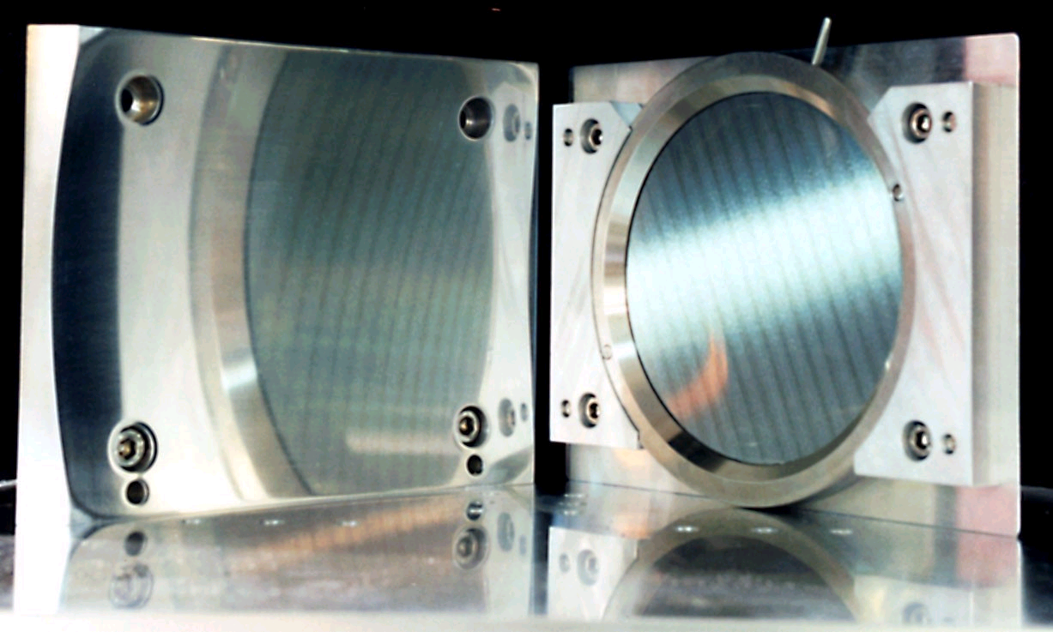
Polarizing Wire Grids
Polarizing wire grids, using fine tungsten wire wound onto a metal frame are the main signal processing component in this and other QO systems, allowing polarization coded splitting and recombination of beams.
A non-reciprocal device is needed to rotate the beam.

Slide 11
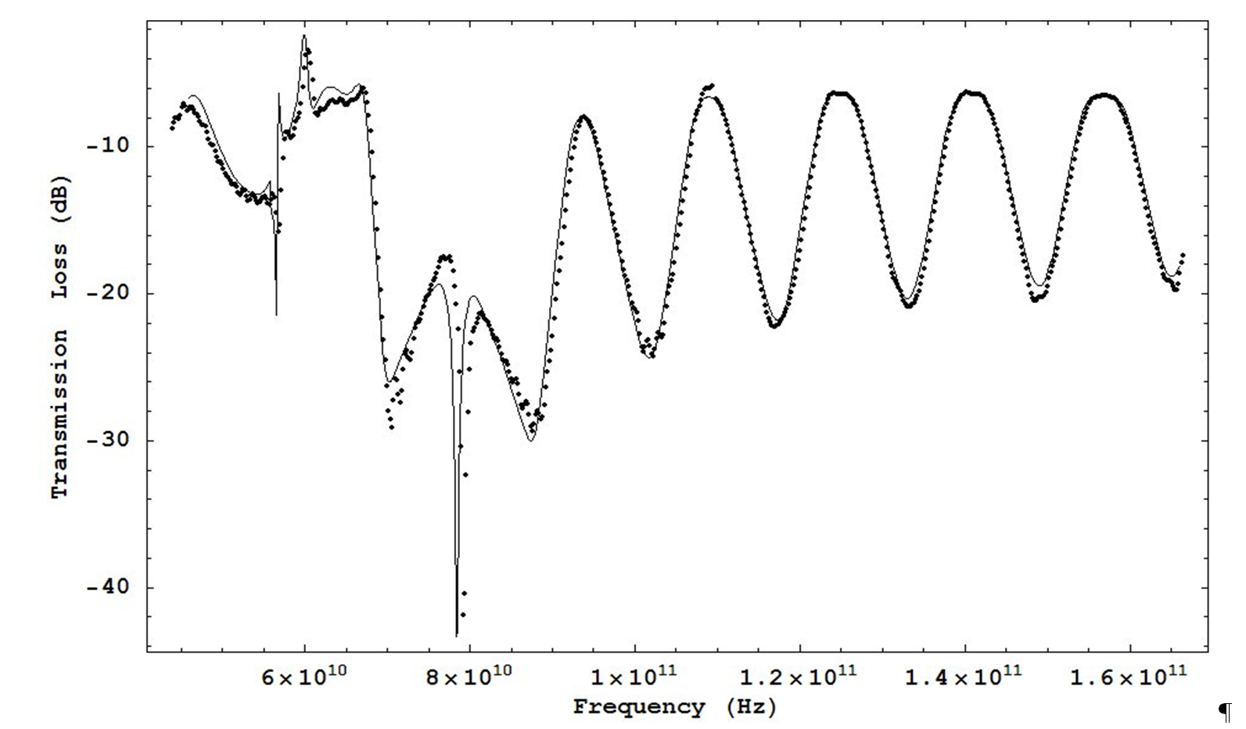
A QO bench with a VNA allows us to generate a transmission spectrum of the Ferrite material.
It is complicated, but, amazingly, we can fit it with four parameters.
Dots are measurements & line the model.
Notice in dB!
This fit is very precise, and gives us strong comfort that our model is a good one.

Slide 12
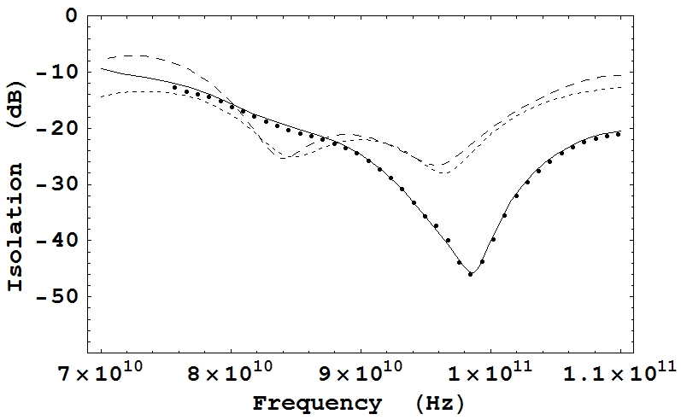
94 GHz Isolation –
Theory and Experiment
The predicted isolation (the continuous line) and back-reflectances (co-polar: long-dash line; cross-polar: short-dash line) for a circulator designed to give optimum performance at 100 GHz. The points are measured isolations

Slide 13
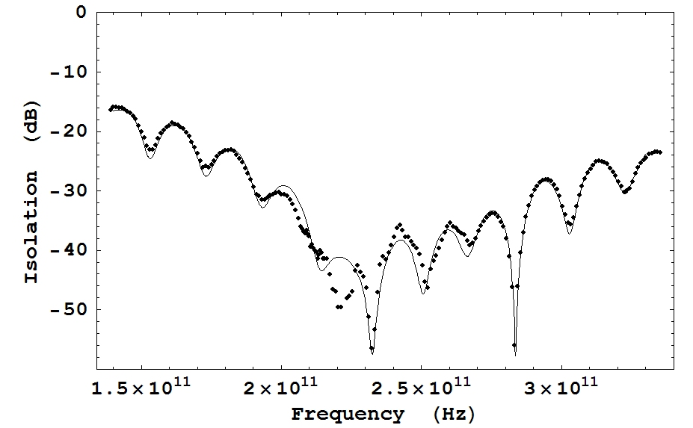
Isolator - Wideband
performance >100 GHz
The isolation of a circulator designed for optimum
performance at 240 GHz. The line is the predicted
performance and the points are the measured values.

Slide 14
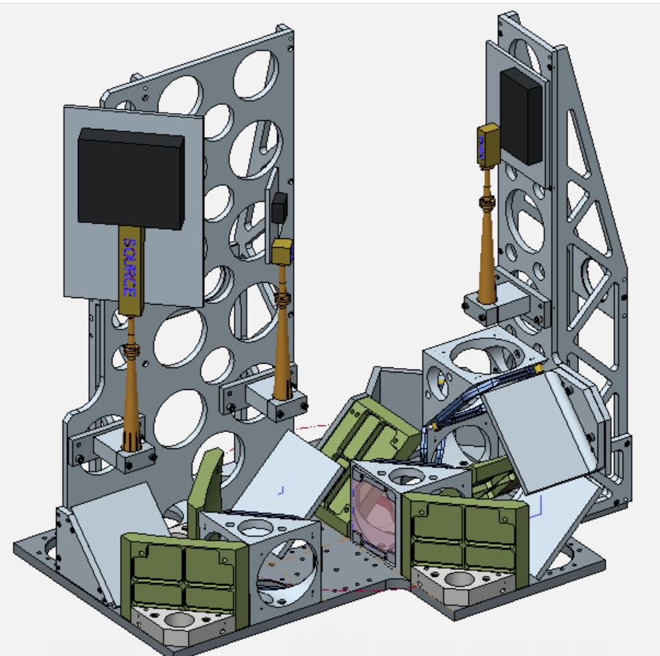
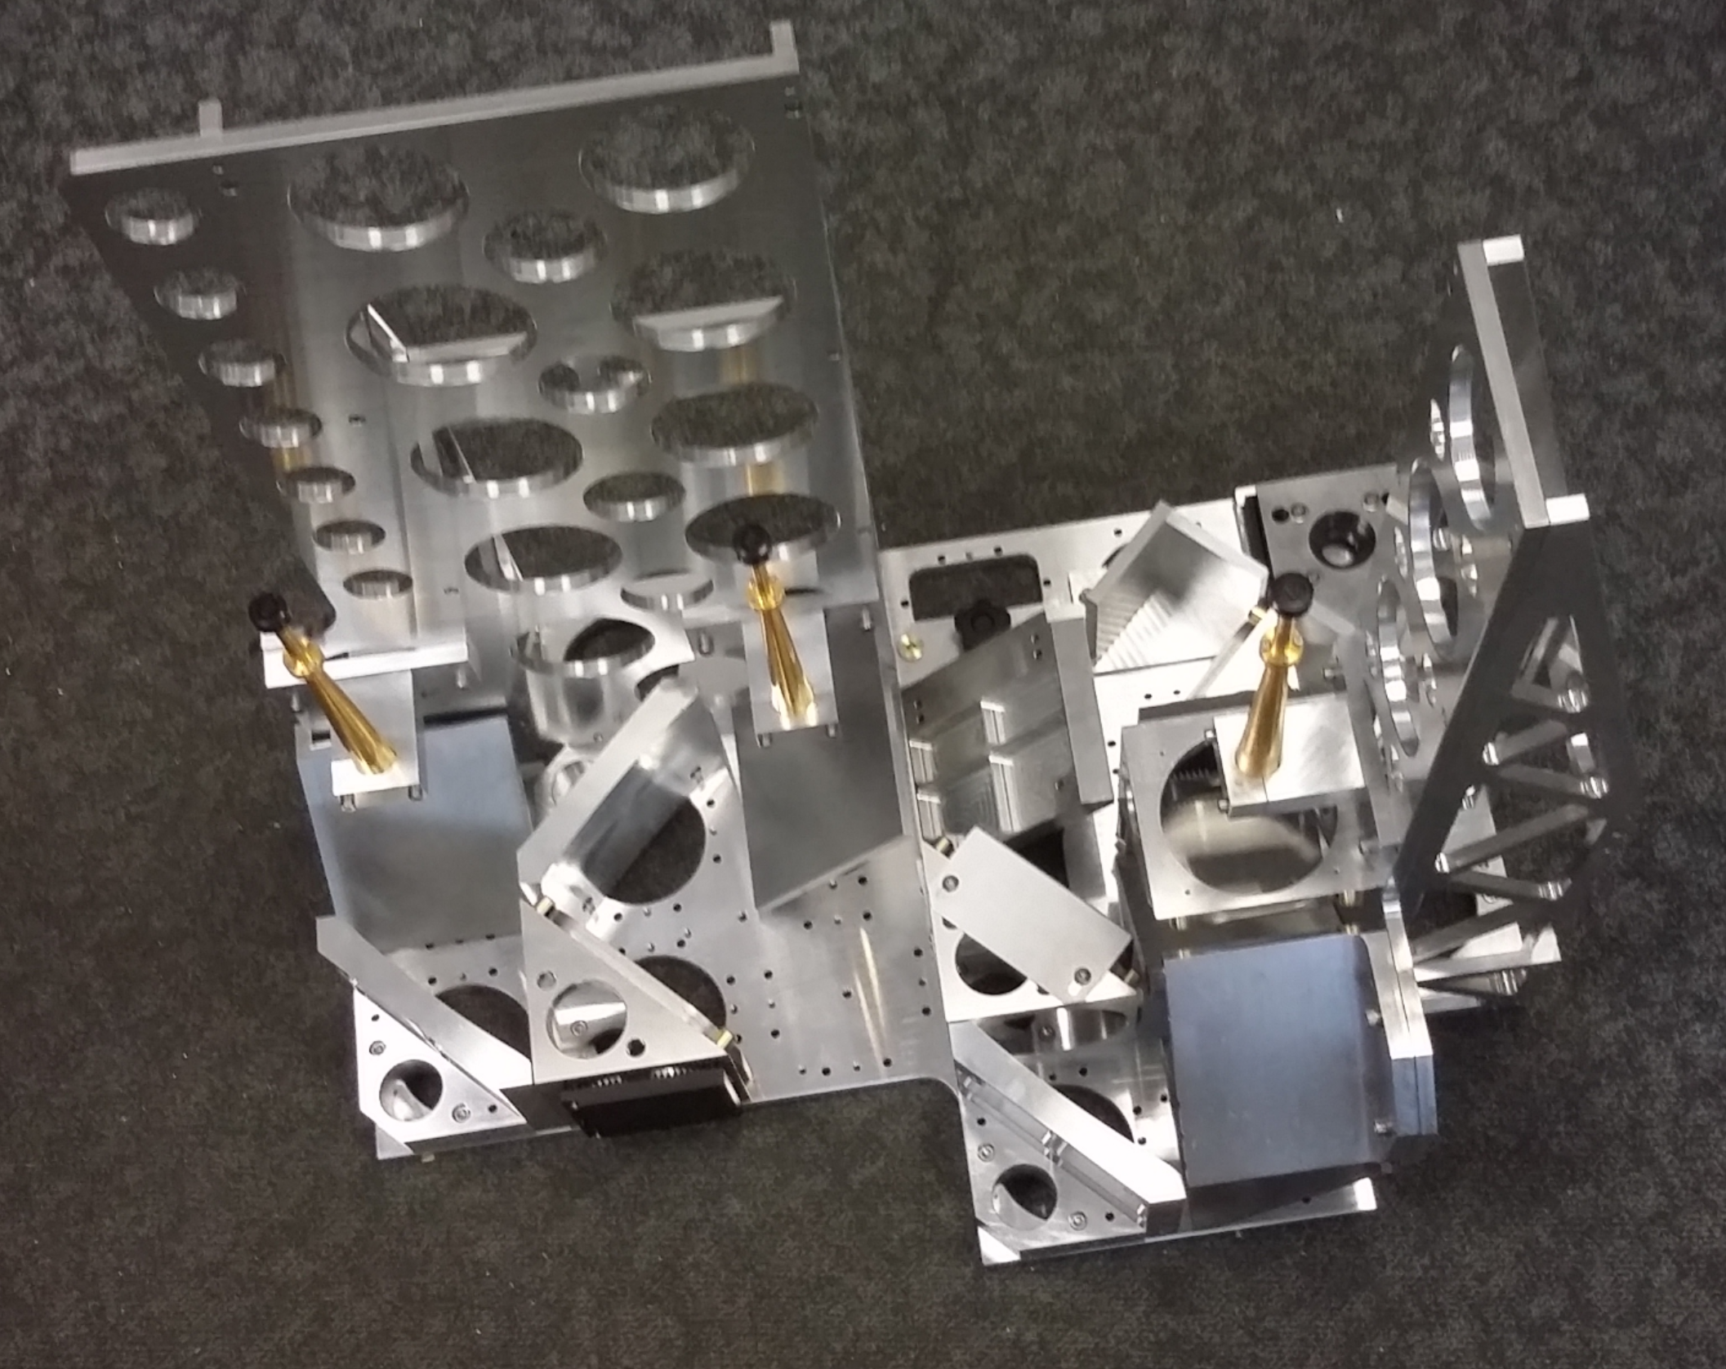
HF EPR enabled by
Quasi-Optical Components
All of these appear in our HF EPR Bridges – and many other Instruments besides
100 & 200 GHz ESR Bridge for Neutron Scattering Experiments
Collin Broholm – Johns Hopkins

Slide 15
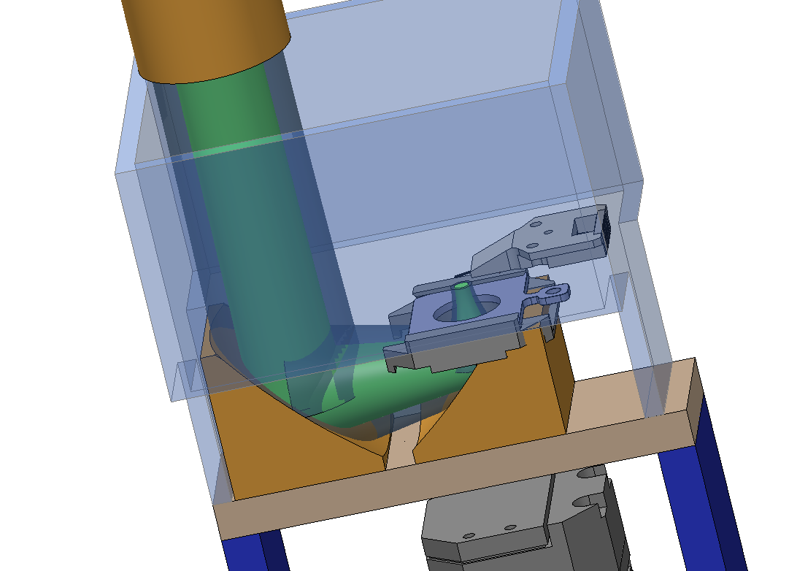
Initial work between TK and Nenovision

