Slide 1
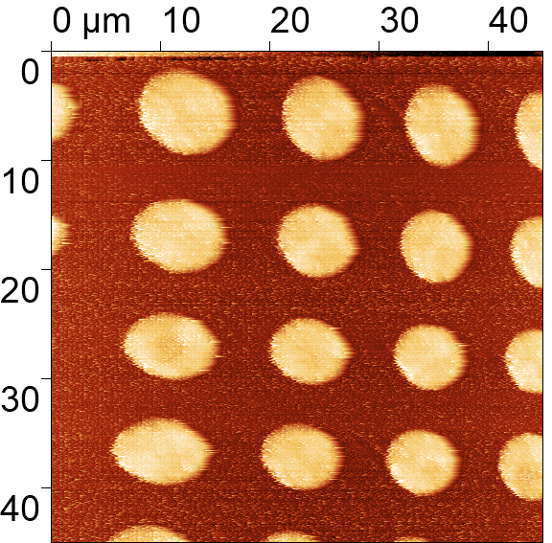
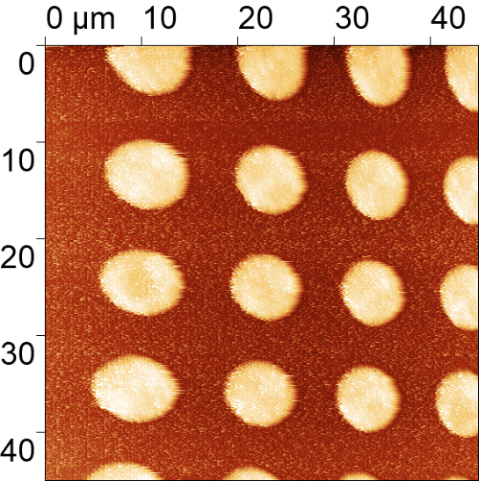
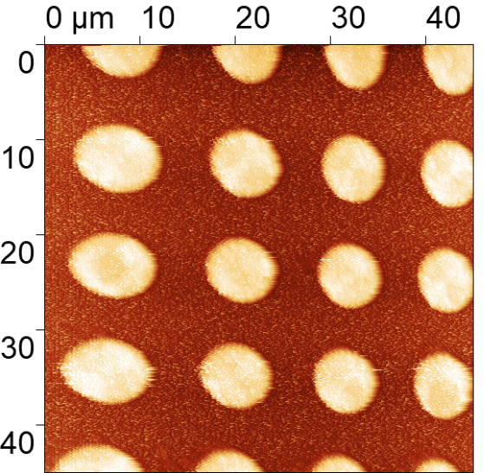
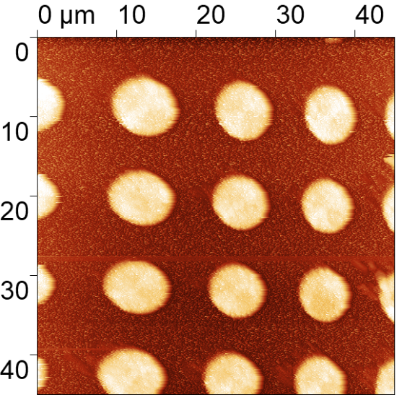
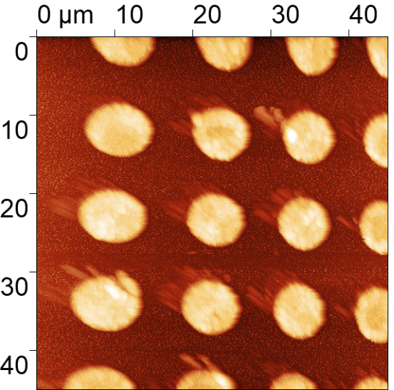
Testing of SPM part of PETER unit in magnetic field
In cryostat at 257 K and 0 T
In cryostat at 257 K and 1 T
In cryostat at 257 K and 3 T
In cryostat at 257 K and 6 T
In cryostat at 257 K and 12 T

Slide 2
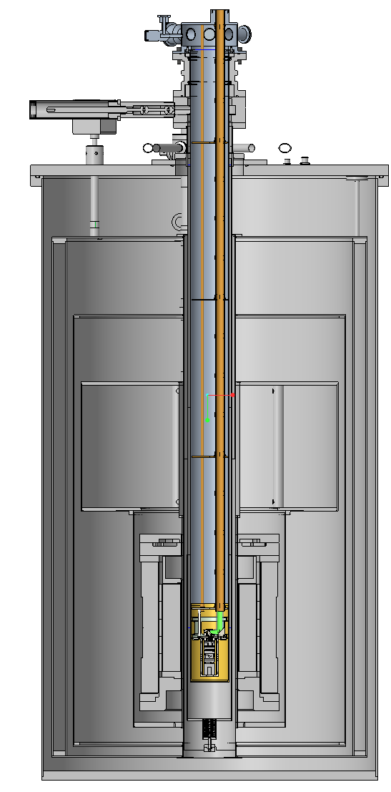
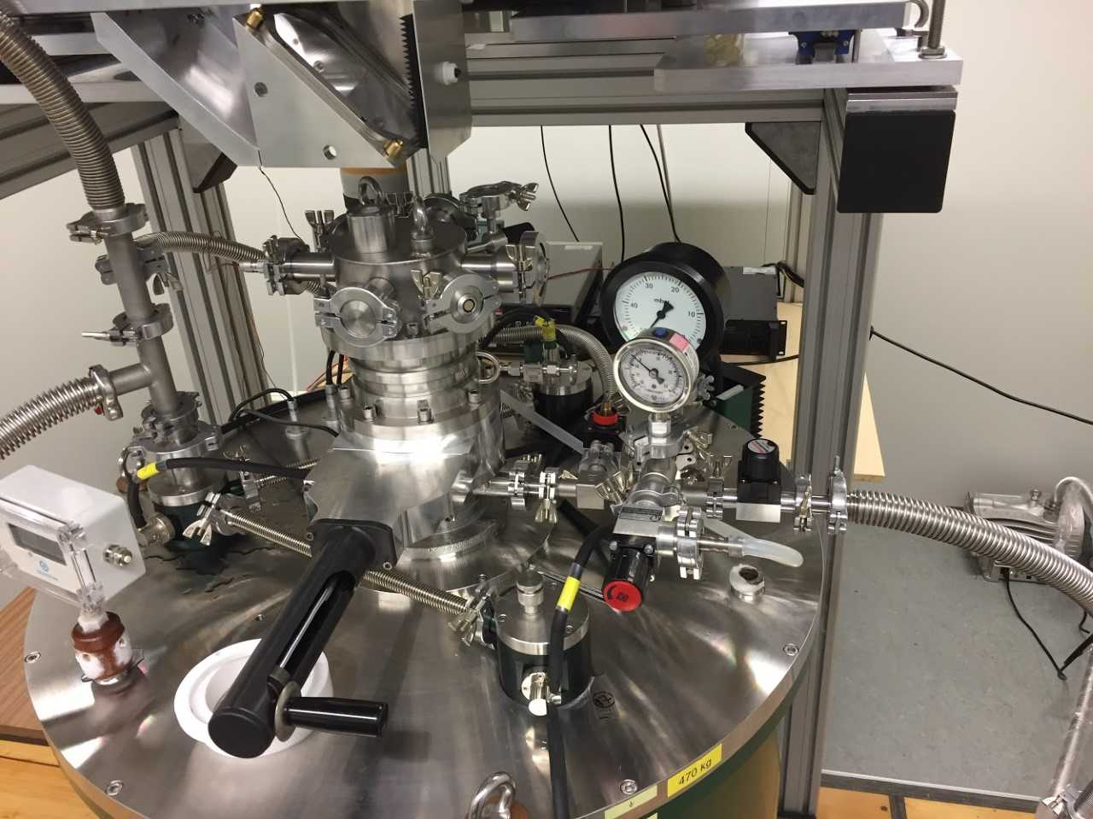
Microwave path
from a source and to
a detector
LT department
Pump
He recovery line
Liquid N₂
reservoir
Liquid He
reservoir
PETER SPM
unit

Slide 3
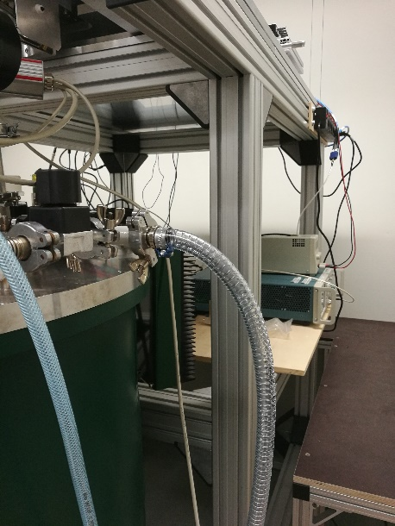
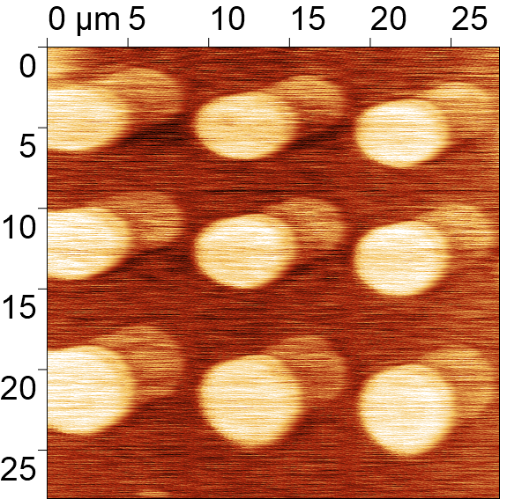
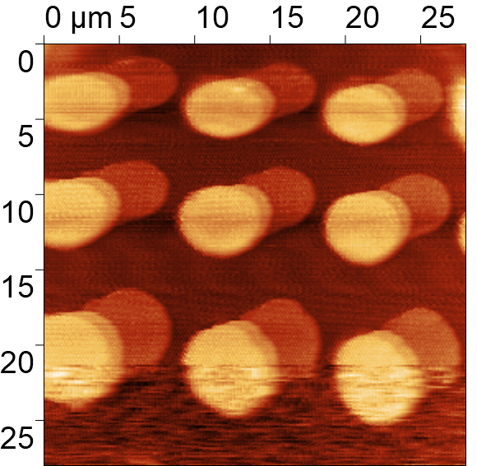
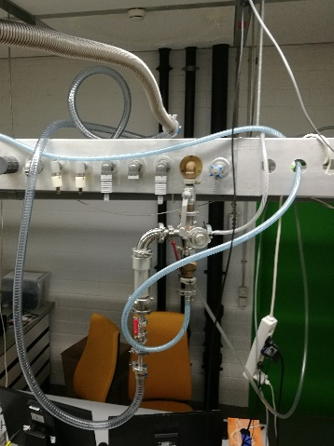
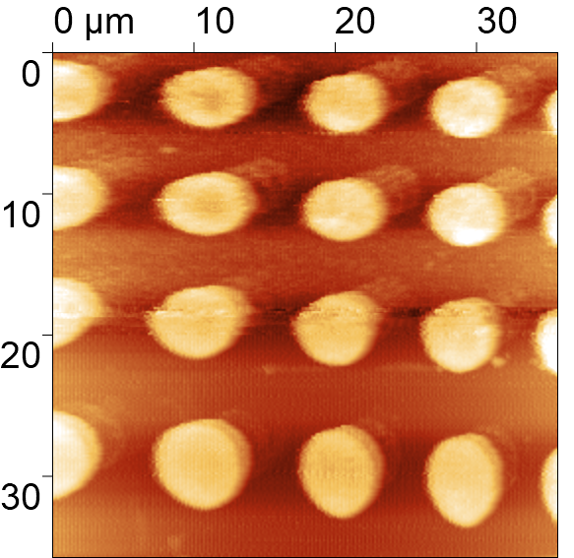
Testing of SPM part of PETER unit in magnetic field at low temperature
Fixed tip – new PVC tube
Fixed tip – new PVC tube
In cryostat at 10 K (13 K) and 0 T
In cryostat at 10 K (13 K) and 0 T
18 K
Pump OFF
13 K
Pump ON
13 K
Fixed tip – new PVC tube
In cryostat at (148 K) and 0 T
Needle valve OPEN
Pump ON
Needle valve CLOSED
Pump ON

Slide 4
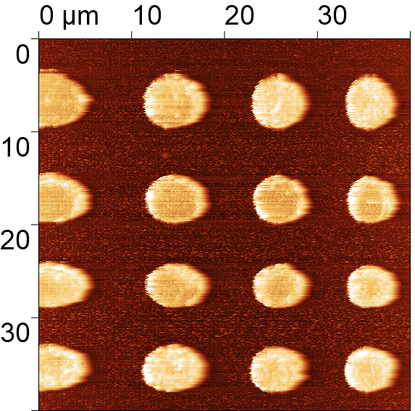
Tip condition after single AFM scan of the calibration sample
AFM scanning parameters:
Scan field: 40 µm x 40 µm
Scan resolution: 512 x 512 points
Scan rate: 0.25 Hz (i.e. 20 µm/s)
Total scan time: cca 40 minutes
Environment: RT and in Air
Discs height: 120 nm
Before scanning
After scanning
After scanning (detail)
Tip apex

